Slide 1

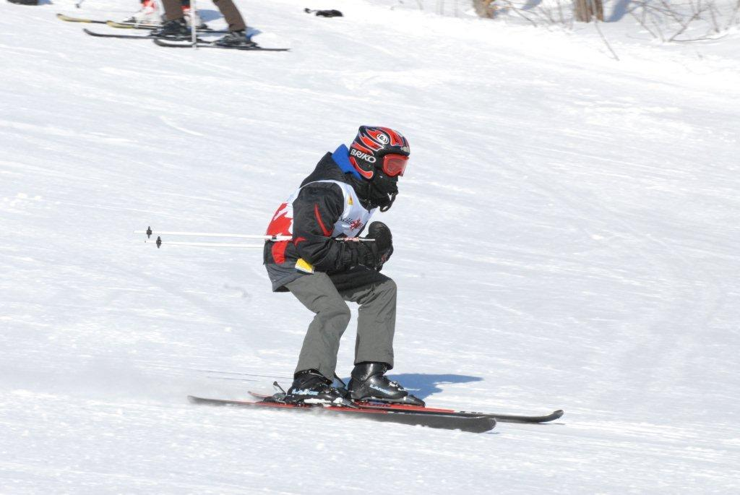
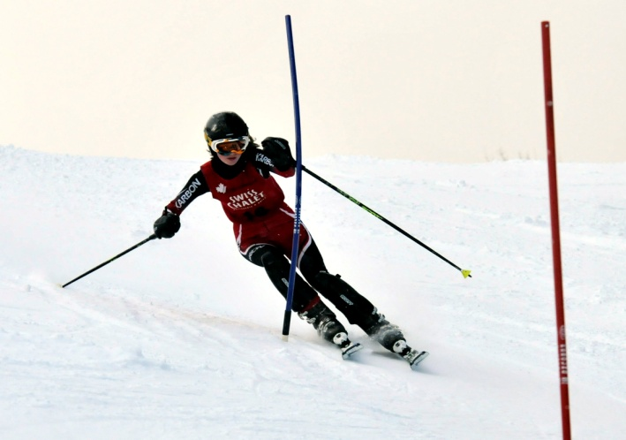
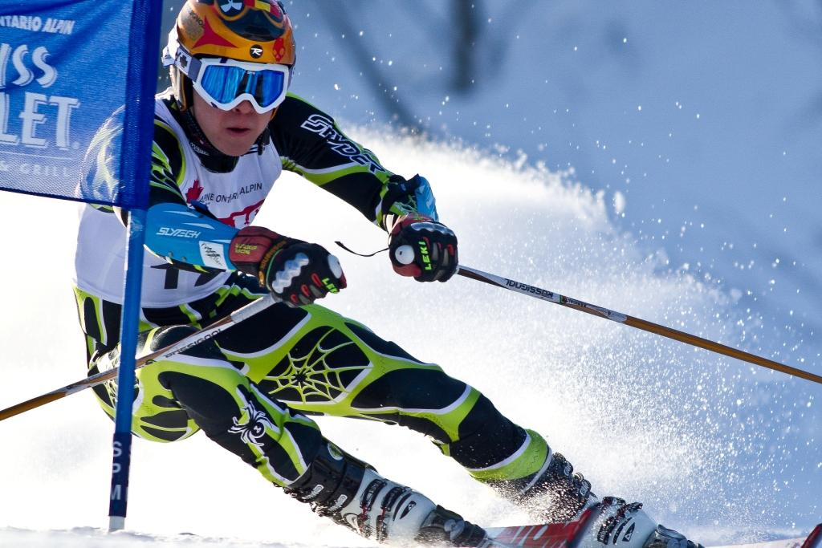
Glacier Ski Club
Welcome presentation

Slide 2
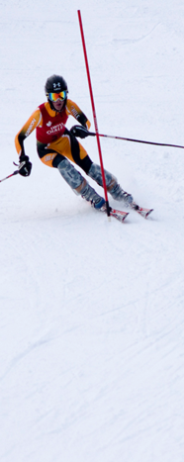
Overview
About Glacier
Who’s who
Structure of ski racing
Camps
Volunteering
MSLM

Slide 3
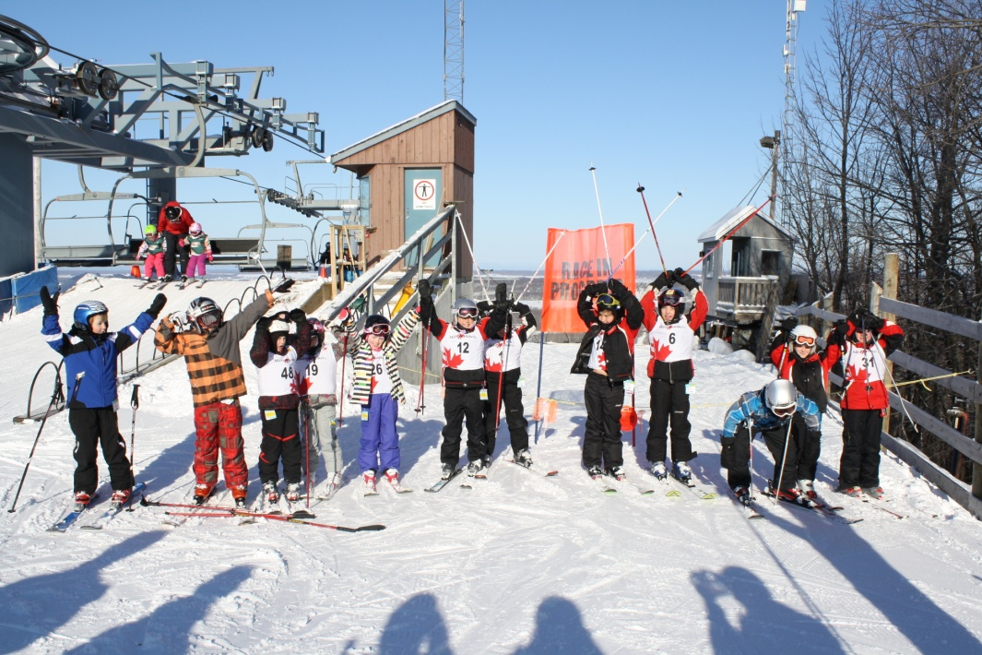
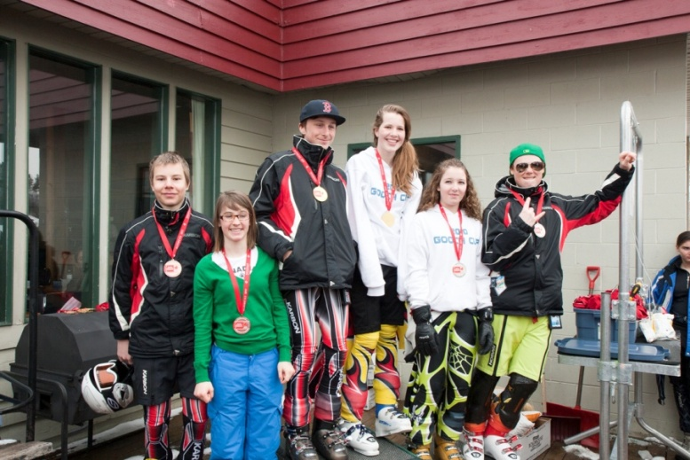
Glacier… the Spirit
Develop racers who have a lifelong love of skiing
Strong technical skills
Strong team commitment
Keeping it fun!

Slide 4
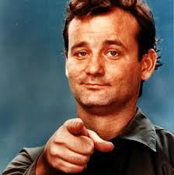
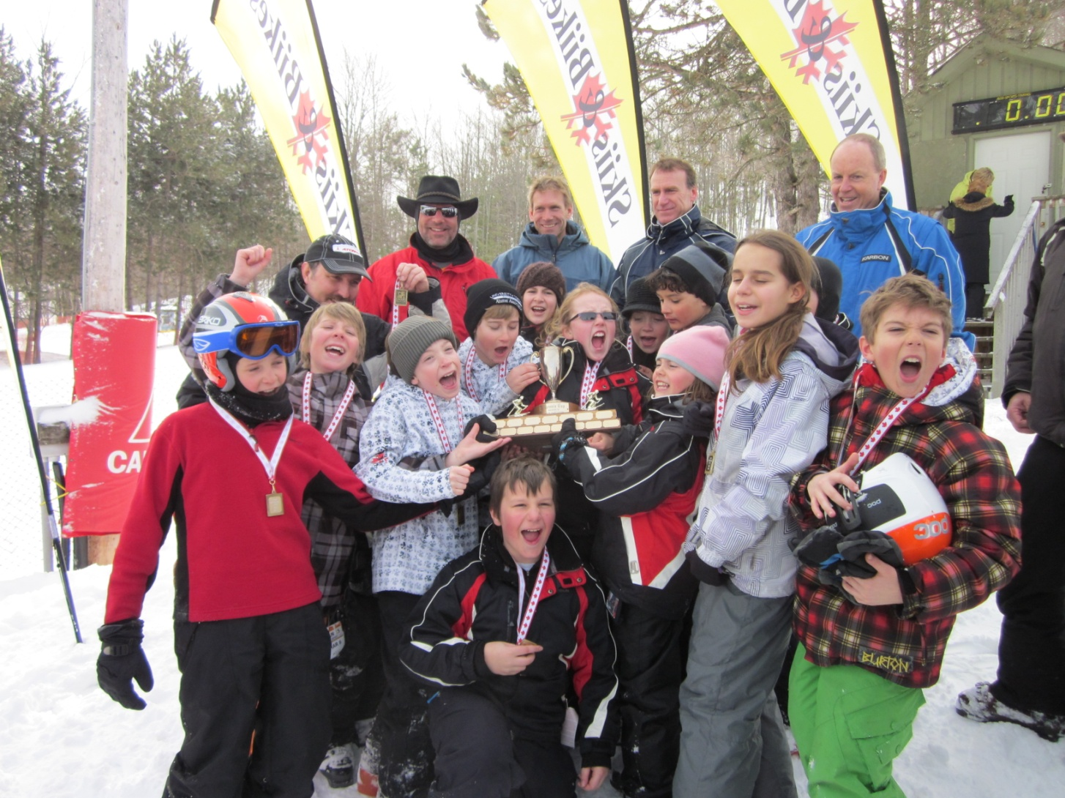
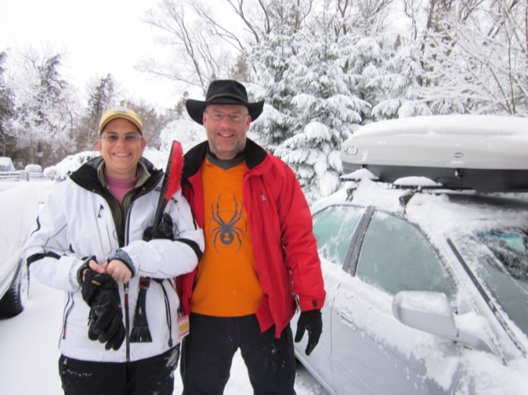
What makes it work
We Need You to Volunteer !
You make it work - be a Volunteer
Competitive, and fun
Family & parent run
Safety first
We Can’t Wait to Volunteer – It just snowed!

Slide 5
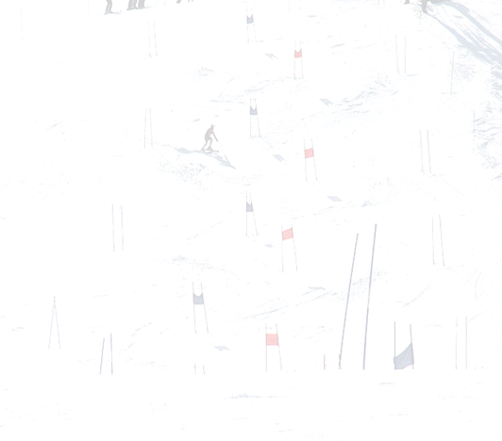
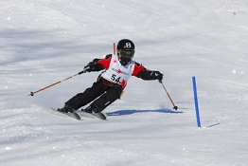
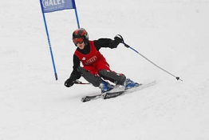
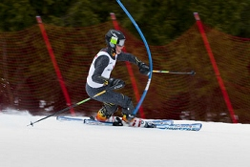
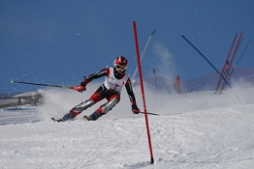
… the club
Board and their roles
Coaching staff
Managers
AOS administrator, scoring administrator, clothing prime
Hosting races
Race admin
On the hill
Timing
Officials

Slide 6
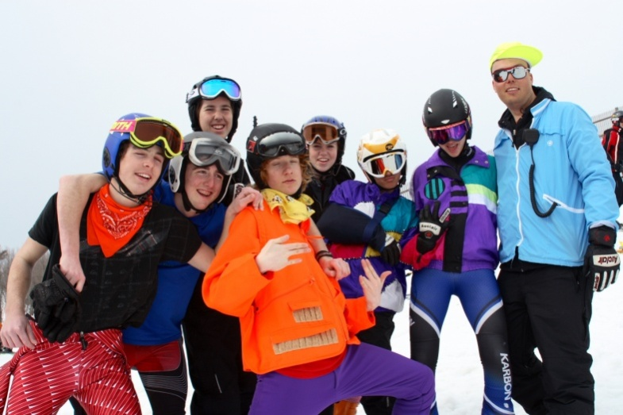
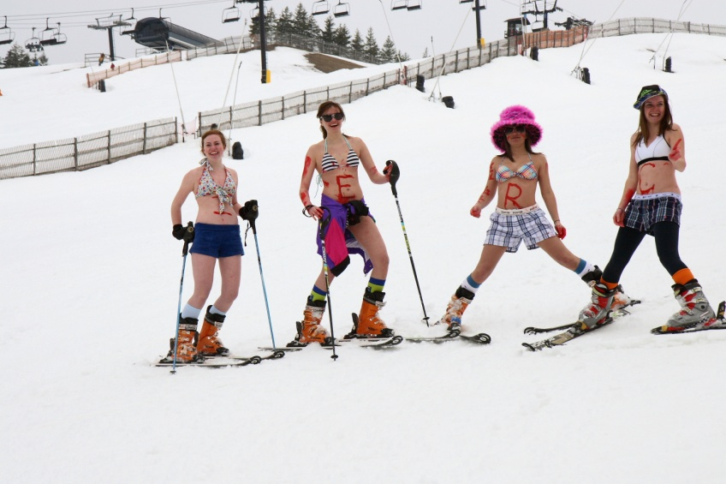
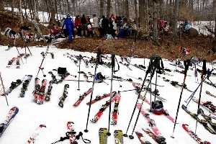
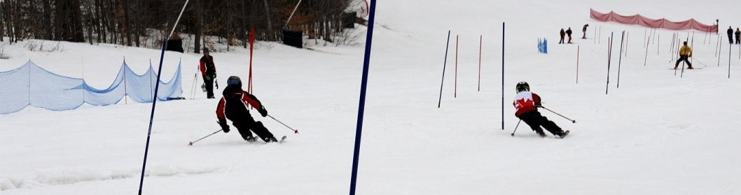
The club … Social
Annual AGM & BBQ
Skiesta – 1st Sat in March
Meet & greet Today with MSLM
Fun!

Slide 7
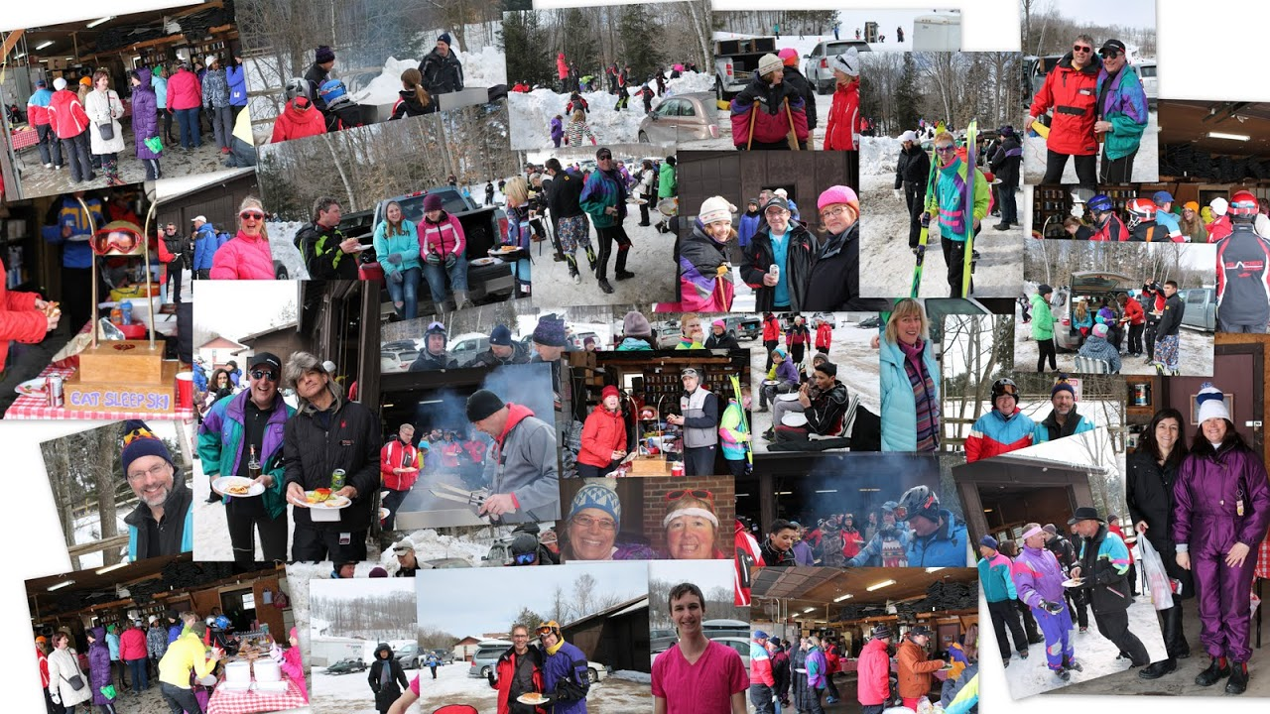
Skiesta!

Slide 8






Org Structure of the Sport
BC
AB
MN
PQ
We’re Here

Slide 9

AOSD (Alpine Ontario South Division
31 ski clubs
area from Belleville to London and Milton to Huntsville and Collingwood
70% of Alpine Ontario

Slide 10
How it works…
Alpine Ontario - http://www.alpineontario.ca
Age group dependent (as of December 31st)
U8 - 6 and 7 year olds
U10 – 8 and 9 year olds
U12 – 10 and 11 year olds
U14 – 12 and 13 year olds
U16 – 14 and 15 year olds
U18/21 – 16, 17, 18, 19 and 20 year olds
Alpine Ontario has transitioned over last 2 years to current format
New age groups
Individual scoring
Two Divisions – 1 and 2 for U14 and U16
Kids in all groups will have opportunities for additional races – depending upon ability

Slide 11
How it works…
Groupings – Teams you race against
6 to 7 teams in each group
Race against the whole field of kids – not just one other team
Number of Races vary by Division
FunSki for U10
4 regular races for U12 (one race at MSLM this year)
5 regular races for U14 and U16 (one race each at MSLM this year)
6 regular races for U18/U21 – pay as you go

Slide 12
2 Divisions - for U14 and U16 only
Division 1 - more intensive racing (formerly individual)
Division 2 – basic competitive racing (formerly Tier 1 and 2 team)
Division 2 athletes are eligible to compete in a maximum of 3 SOD Division 1 events throughout the season (does not include Provincials)
Division 2 athletes can qualify for the next Division 1 event by placing in the top 5 in a Division 2 event - This qualifying spot can only be applied to the next Division 1 calendared event
We are here

Slide 13
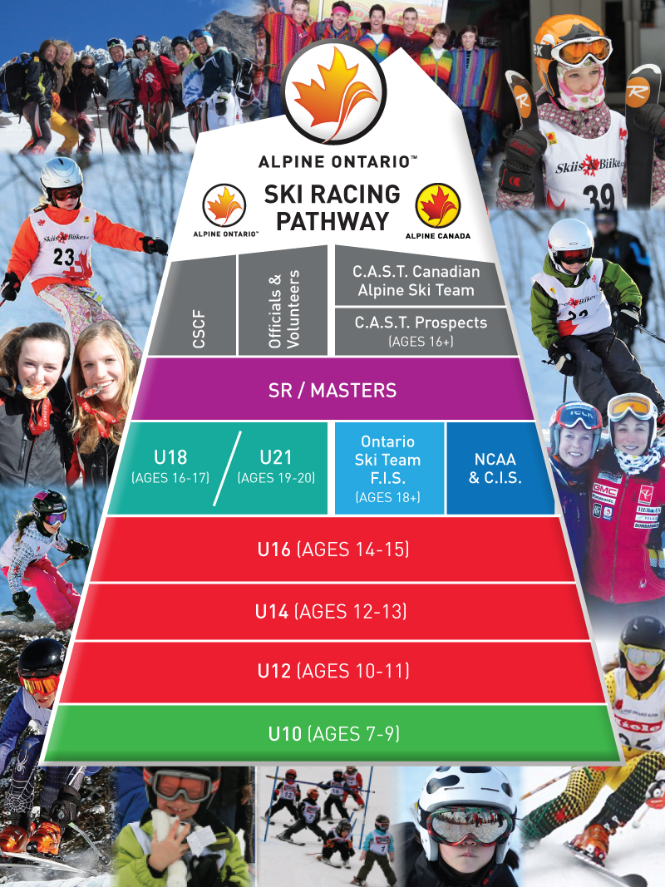

Slide 14
Additional Training
Wednesday (night) training
Need a minimum number of participants (six),
Cost - $30/racer (also value books of four and eight)
Extra training will be announced when available
Contact Coach John Johnston
Friday training
Need a minimum number of participants (six),
Cost - $35/racer (also value books of four and eight)
Extra training will be announced when available
Contact Coach John Johnston
AOS Camps – Sign up through Alpine Ontario
Pre-season Tremblant Camp
Check out the Alpine Ontario website Calendar

Slide 15
Volunteering
Glacier is run by the parents!
Parents are expected to volunteer
Team management
Board and Administration
Race hosting
Race Crew
Officials
Social Event Organization
Volunteer Organizer
This year, each family is required to volunteer 10 hours over the season
$200 cheque is returned at the end of the season once your volunteer hours have been put in.

Slide 16
Volunteering…
Board
Past President (Karen Whitney)
President (Matt Setterington)
VP Operations (Mark Booth)
Treasurer (Guillaume Gignac)
Secretary – Need one – this year
Directors (3) – Looking for one this year (Anita Montgomery and Rich Martyn)
Administration
Registrar (Ileana Cojocaru)
Race Administration (Noelle Wood)
Clothing Coordinator (Debbie Holmes)
Volunteer Coordinator - Need one
Race crew

Slide 17
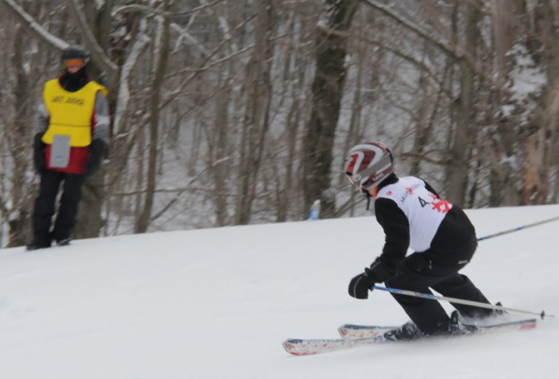
Volunteering…
Race Admin./Hosting
Admin
Bibs
Registration
Tickets
Scoring
Announcer, Scorers
Hill Ops/Race Crew
Setting up/taking down course
Netting
Officials
Gate judges
Technical Delegate, Chief of Gates
Timing hut
Starter

Slide 18
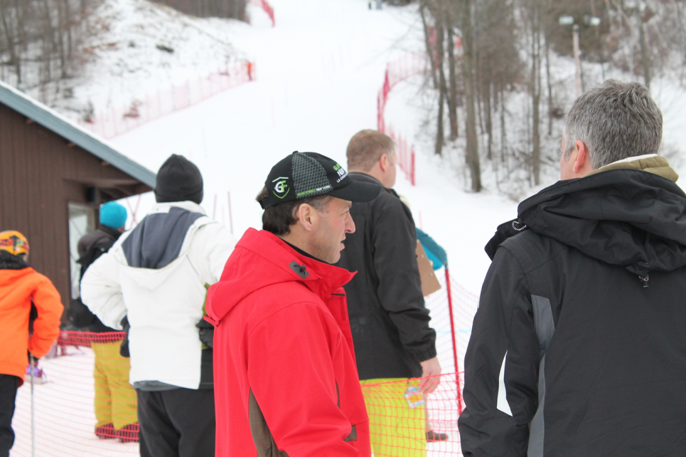
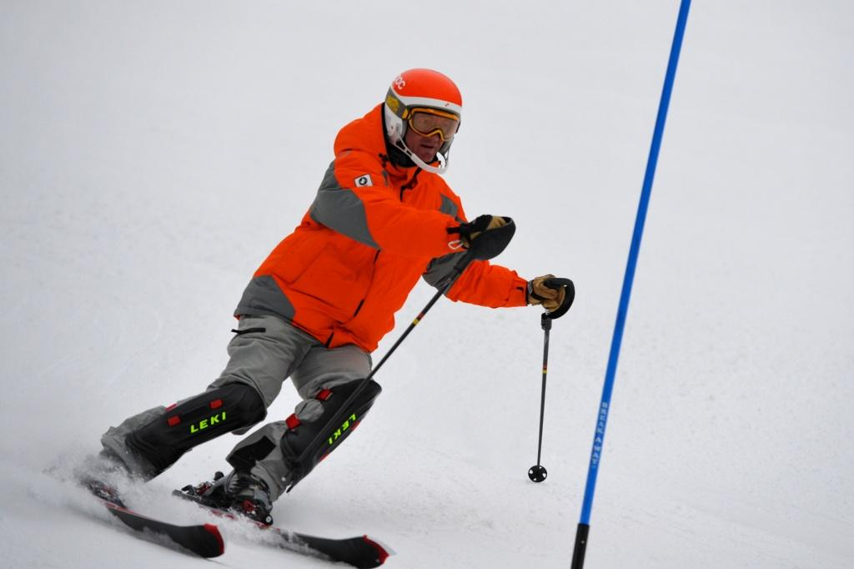
Volunteering …
Team managers
Team admin
Race summary
Race day duties
Recaps – News on Races
Organize Coat Runners
Webmaster – Razie Cojocaru

Slide 19

Mount St. Louis Moonstone
Glacier skis here at MSLM’s graciousness
This relationship is based on
Glacier racers being impeccable ambassadors of good skiing etiquette, manners and the skiers code of conduct
Glacier generating MSLM revenue and promoting skiing!
Point 1 is more important than point 2
– as parents you have a strong duty/obligation to make it happen

Slide 20
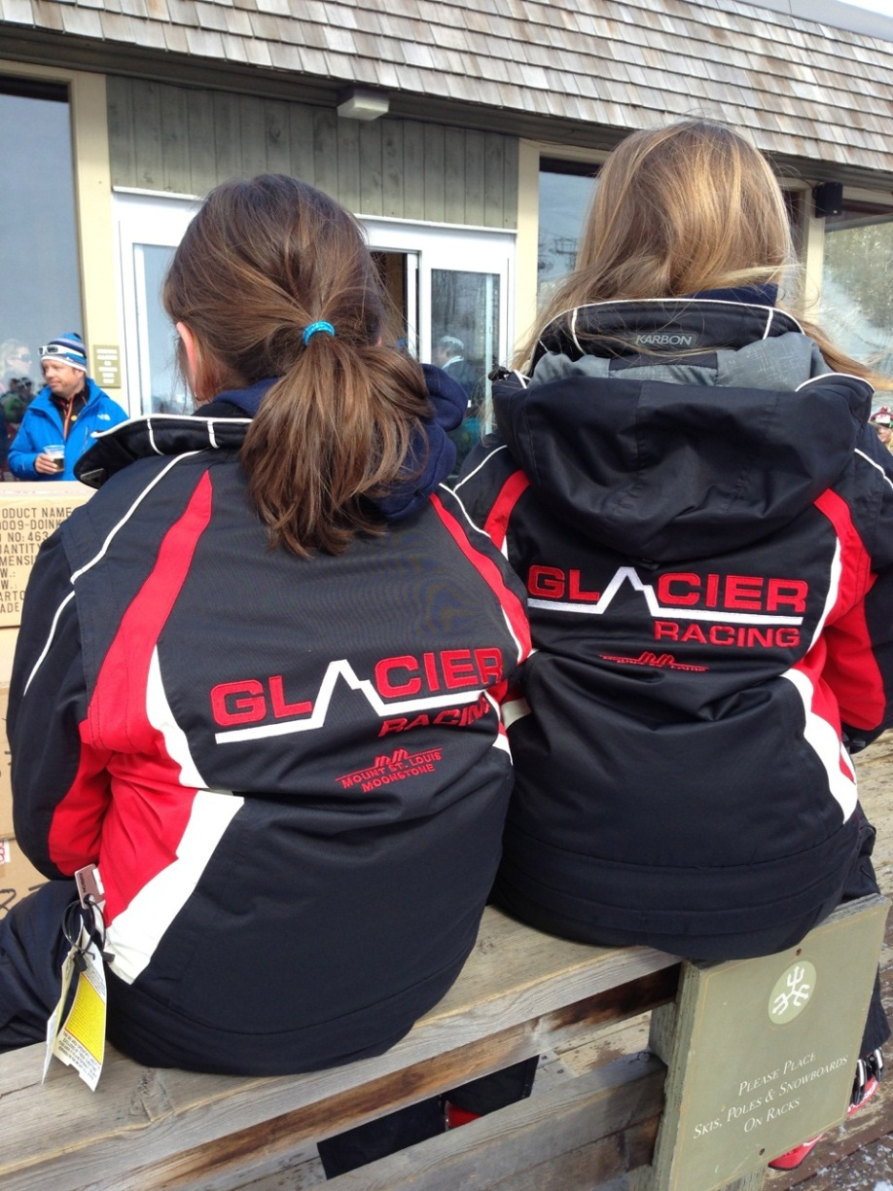
Resources
Glacier and AOS Handbook
Glacier and AOS website
Coaches, board members, any parent who has been with the club longer than you!

Slide 21
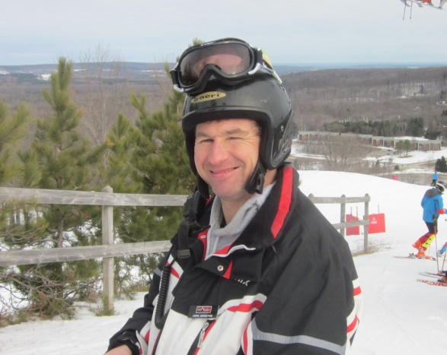
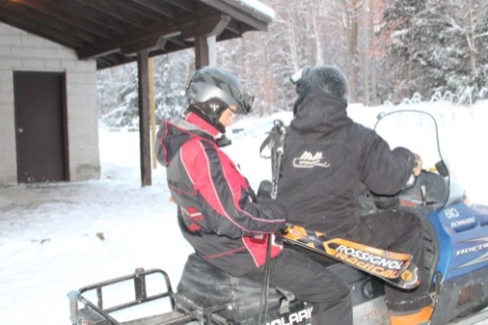
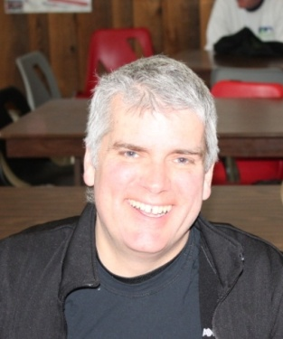
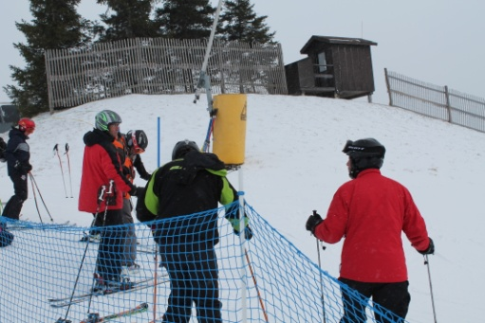
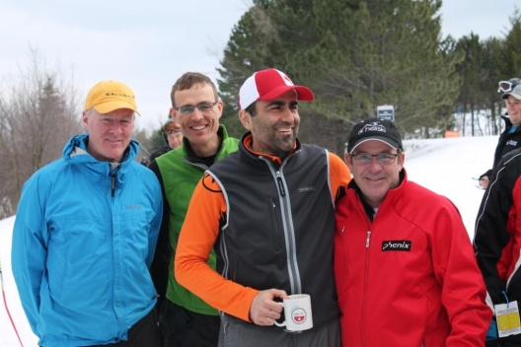
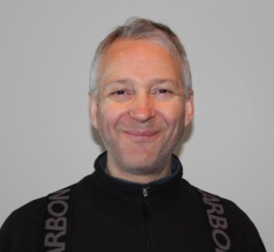
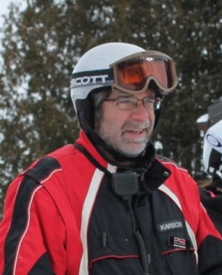
Coaches
Jeff Lee – Head Coach
John Johnston
Stuart Bailey
Marcus Bertagnolli
Razie Cojocaru
Gary Greene
Mike Mandal
Anne Wellnhofer
Patrick O’Reilly
Doug Sneath
Kevin Sneyd
Marc Wolf
Doug Younghusband
Mentor Coaches

Slide 22

Thank you! Any Questions?

